Slide 1
Digital Findings
Presented By Ben Cotton

Slide 2
Withheld Devices and Data
Cyber Security Issues
Hardware Configuration Control
File Deletions
Failure to Preserve Election Artifacts
Anonymous Logins
Listening Ports and Attempted Connections on Bootup
Internet Connections and History

Slide 3
Withheld Devices and Data
Routers and Network Related Data
Poll Worker Laptops
ICX Devices
ICP Credentials to Validate Configuration Settings or Administrative Settings
Other Devices Connected to Election Network
  192.168.100.1
  192.168.100.11

Slide 4
Cyber Security Issues
Failed to Perform Basic OS Patch Management
Failed to Update AntiVirus Definitions
EAC Certification Defense is NOT Valid In View of the Evidence
  4 .exe Files Created After Dominion Software Install
  45 .exe Files Modified After Dominion Software Install
  377 .dll Files Created After Dominion Software Install
  1053 .dll Files Modified After Dominion Software Install
Log Management - Failed to Preserve Security Logs
Credential Management – Shared Accounts and Common Passwords
Failed to Establish and Monitor Host Baseline
Failed to Establish and Monitor Network Communications Baseline

Slide 5
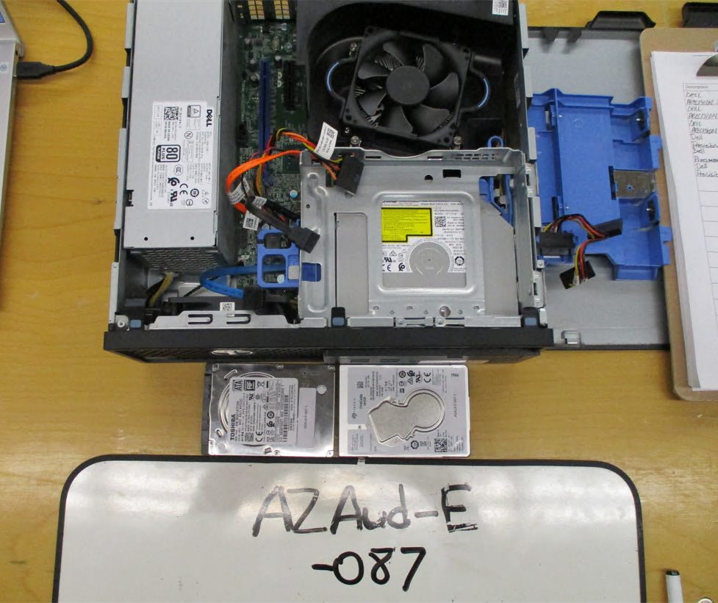
Hardware Configuration Issues
Dual Boot Configuration Discovered on Adjudication 02 Endpoint
  Two Hard Drives Internal to System
  Both Drives Bootable to Different Configurations
Clearly Not an Approved Configuration
2nd Hard Drive Contained Non-Maricopa County Data

Slide 6
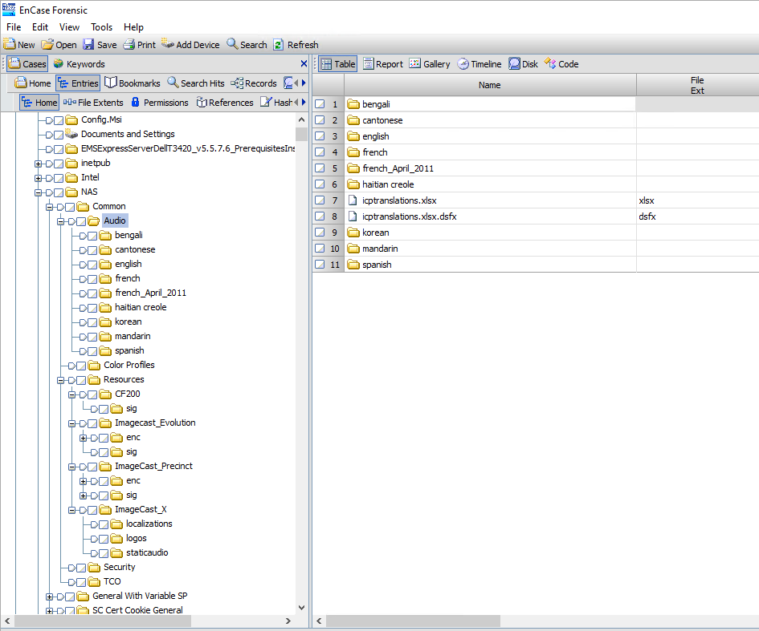
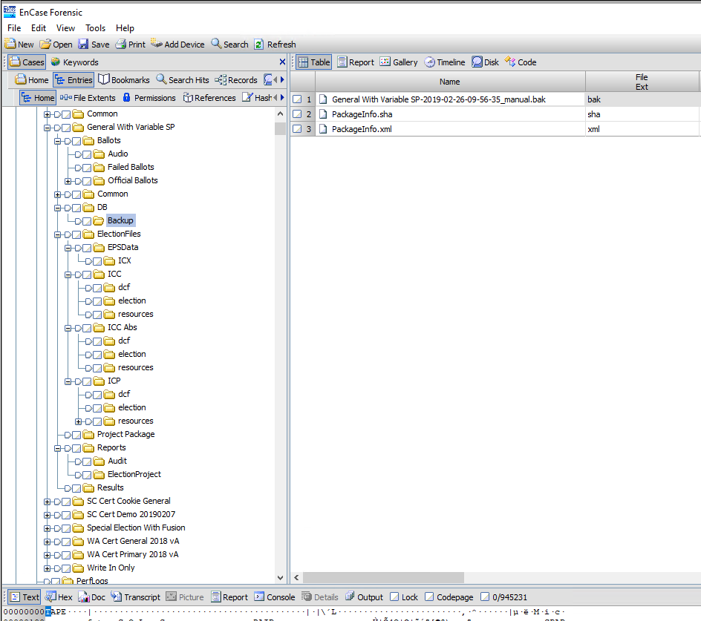
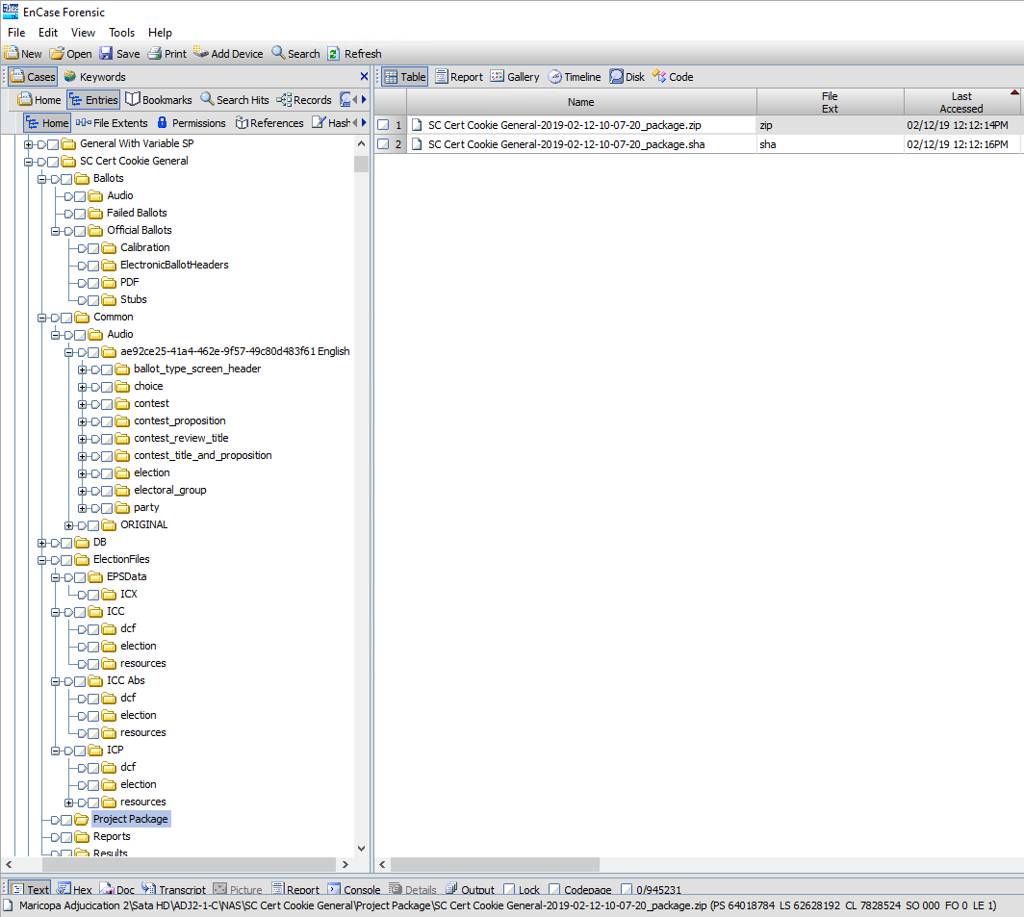
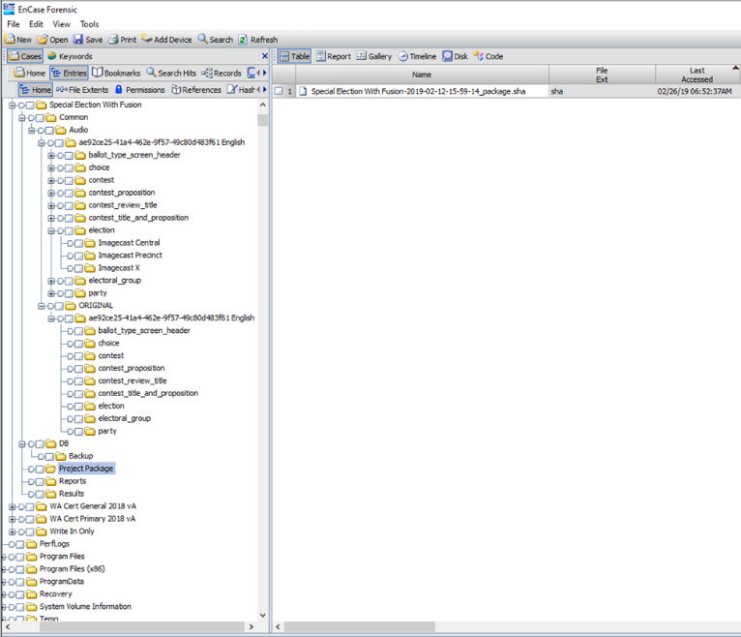
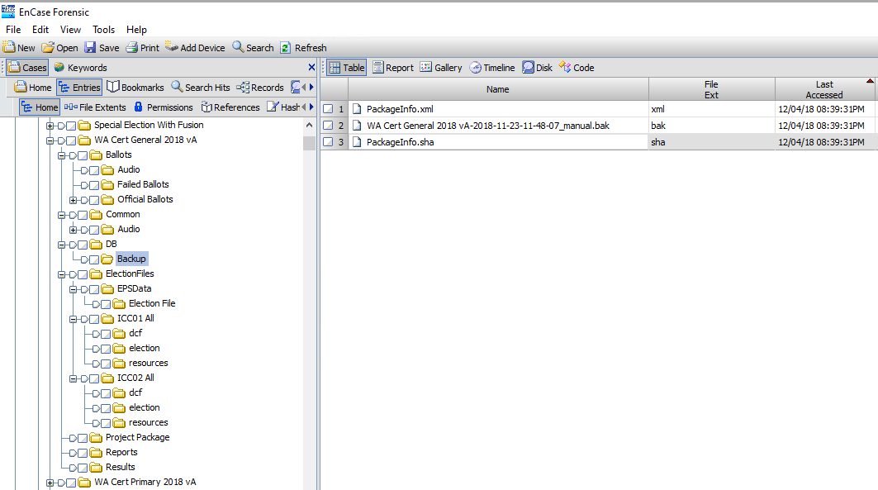
Non-Maricopa County Data

Slide 7
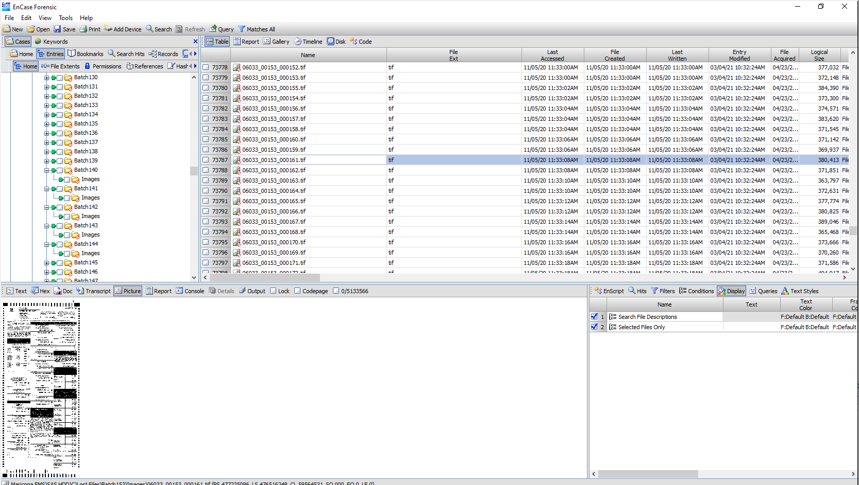
File Deletions From EMS C:\ Drive
865 directories and 85,673 Election Related Files (scanned ballots, .dvd files, slog.txt files, etc) Deleted Between 10/28/20 and 11/05/20

Slide 8
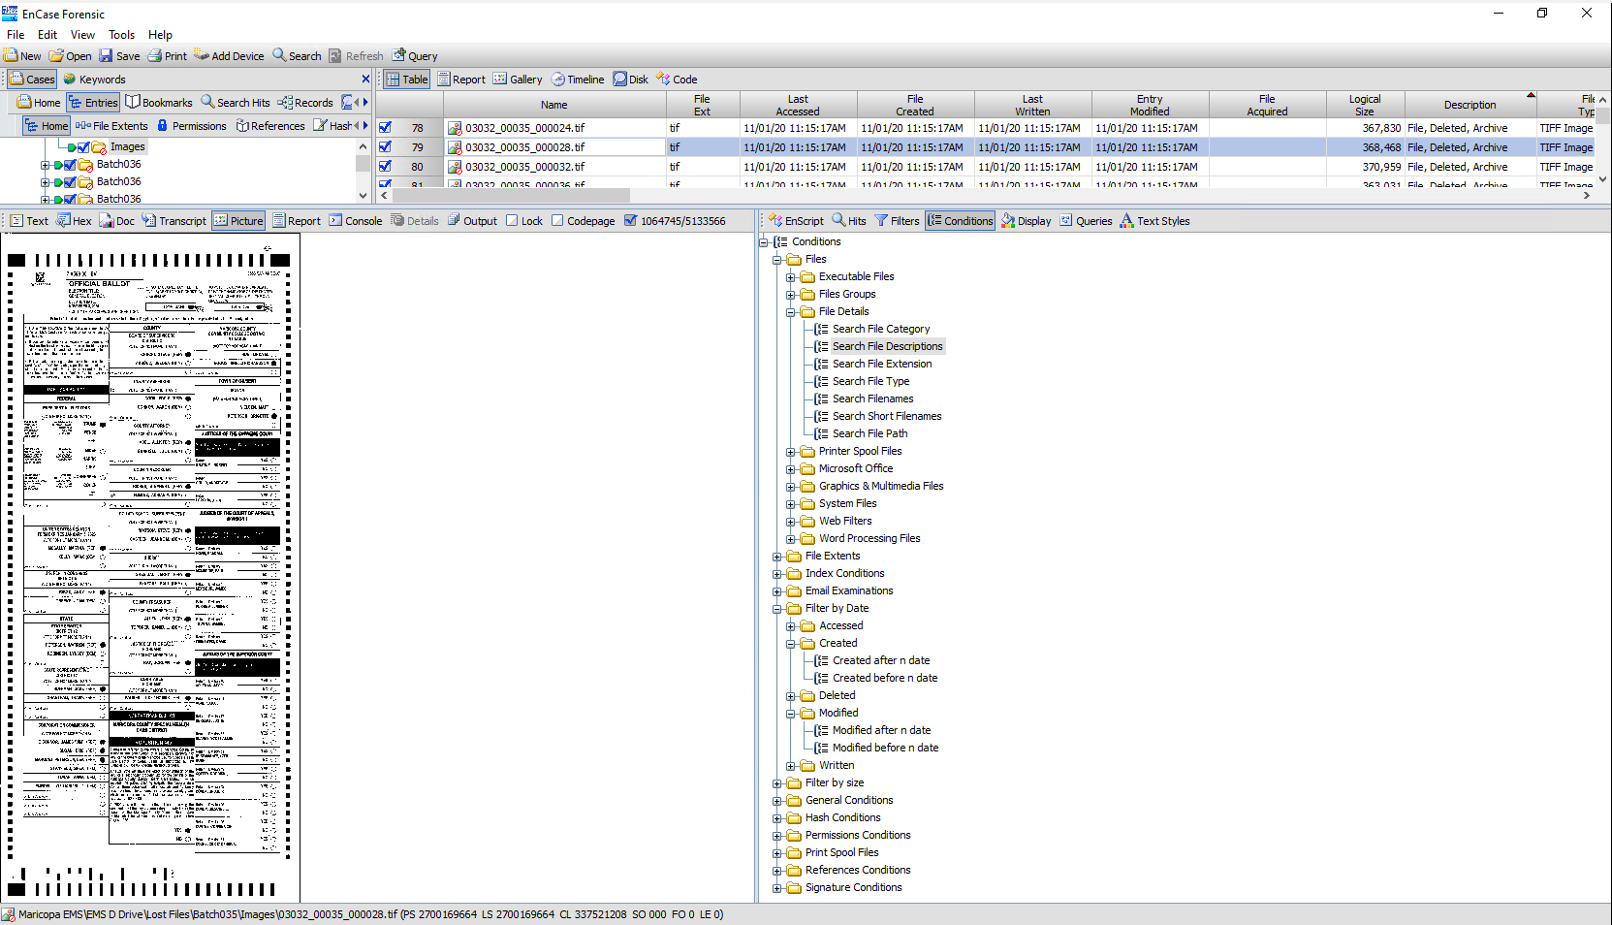
File Deletions EMS D:\ Drive
9,571 Directories and 1,064,746 Election Related Files Were Deleted Between 11/01/20 and 03/16/21

Slide 9
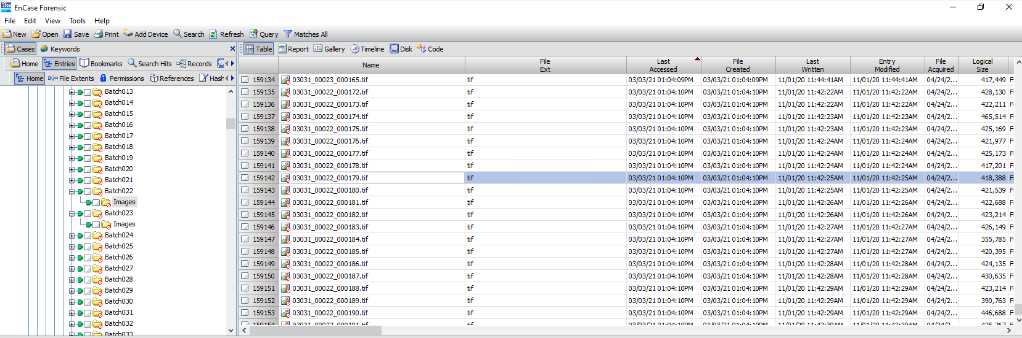
Deleted Files – HiPro 1
304 Directories and 59,387 Files Containing Election Data Deleted From the HiPro Scanner 1 on 3 March 2021

Slide 10
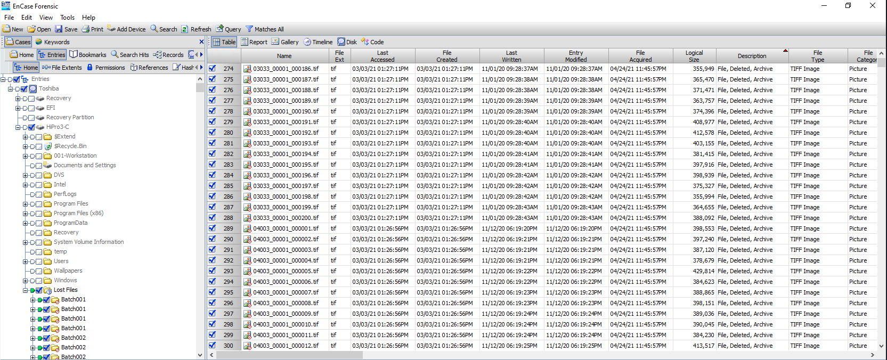
Deleted Files – HiPro 3
1,016 Directories and 196,463 Files Containing Election Data Deleted From the HiPro Scanner 3 on 3 March 2021

Slide 11
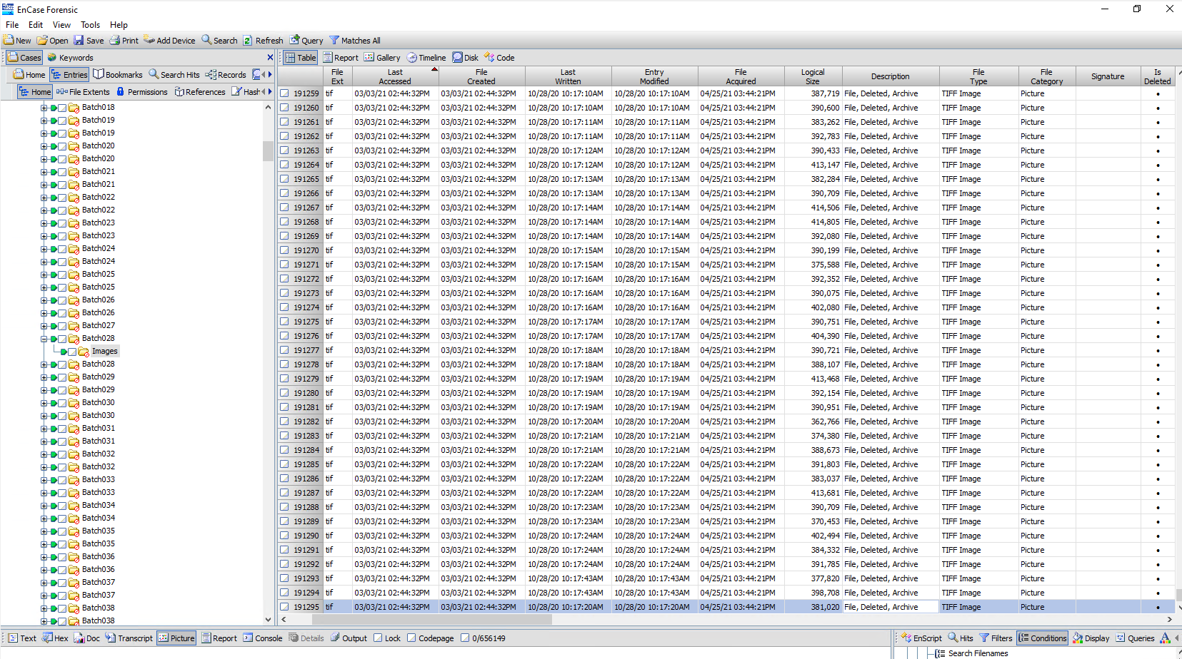
Deleted Files – HiPro 4
981 Directories and 191,295 Files Containing Election Data Deleted From the HiPro Scanner 4 on 3 March 2021

Slide 12
Failure to Preserve Operating System Logs
Logs Produced by Maricopa County Did Not Contain the Windows Security Logs
Security Logs Set to Maintain 20MB of Data
Oldest Date in Windows Security Log on EMS was 2/5/21
  Did not Cover Election Time Period
Clear Intentional Overwriting of the Security Logs by the EMSADMIN Account
  2/11/2021 – 462 Log Entries Overwritten
  3/3/2021 - 37,686 Log Entries Overwritten
  4/12/2021 – 330 Log Entries Overwritten

Slide 13
General Election Results Purged from EMS
2/1/2021 – SQL Logs Indicate That the RTRAdmin Account Purged the General Election Results from the Database
Windows Access Logs Don’t have a Corresponding Entry

Slide 14
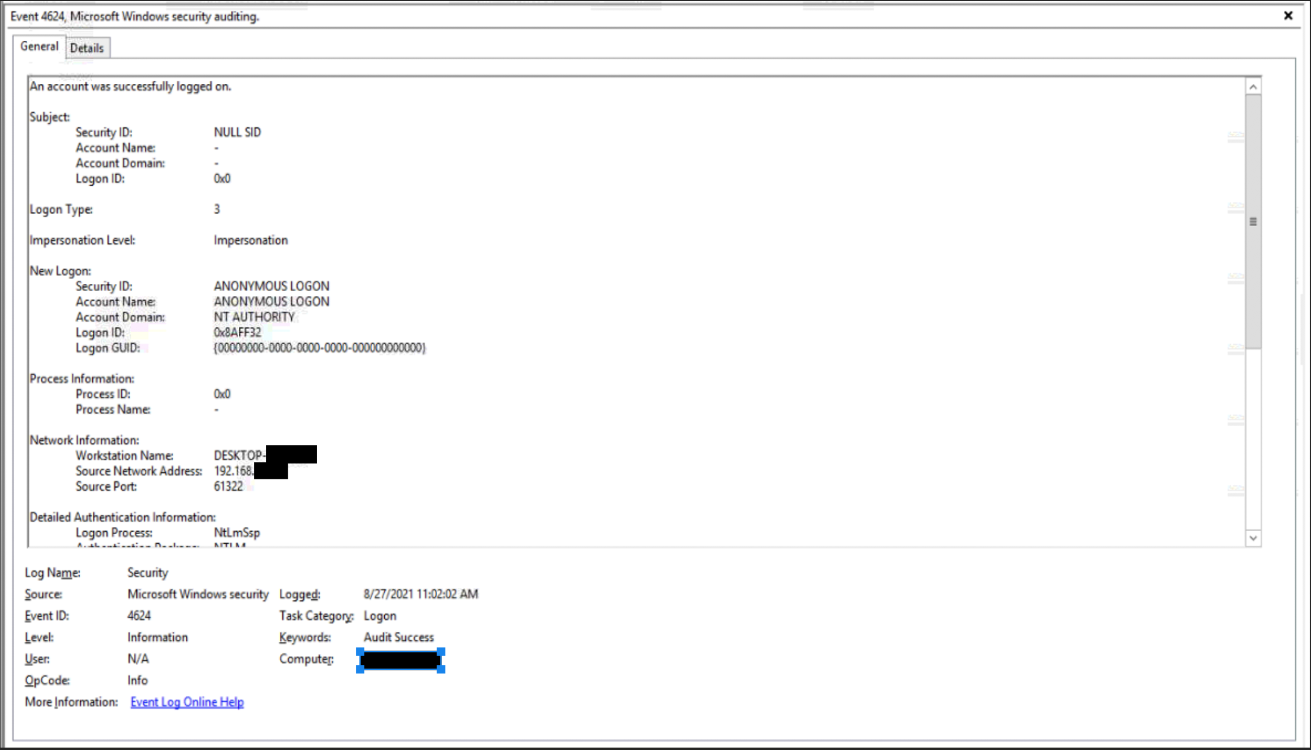
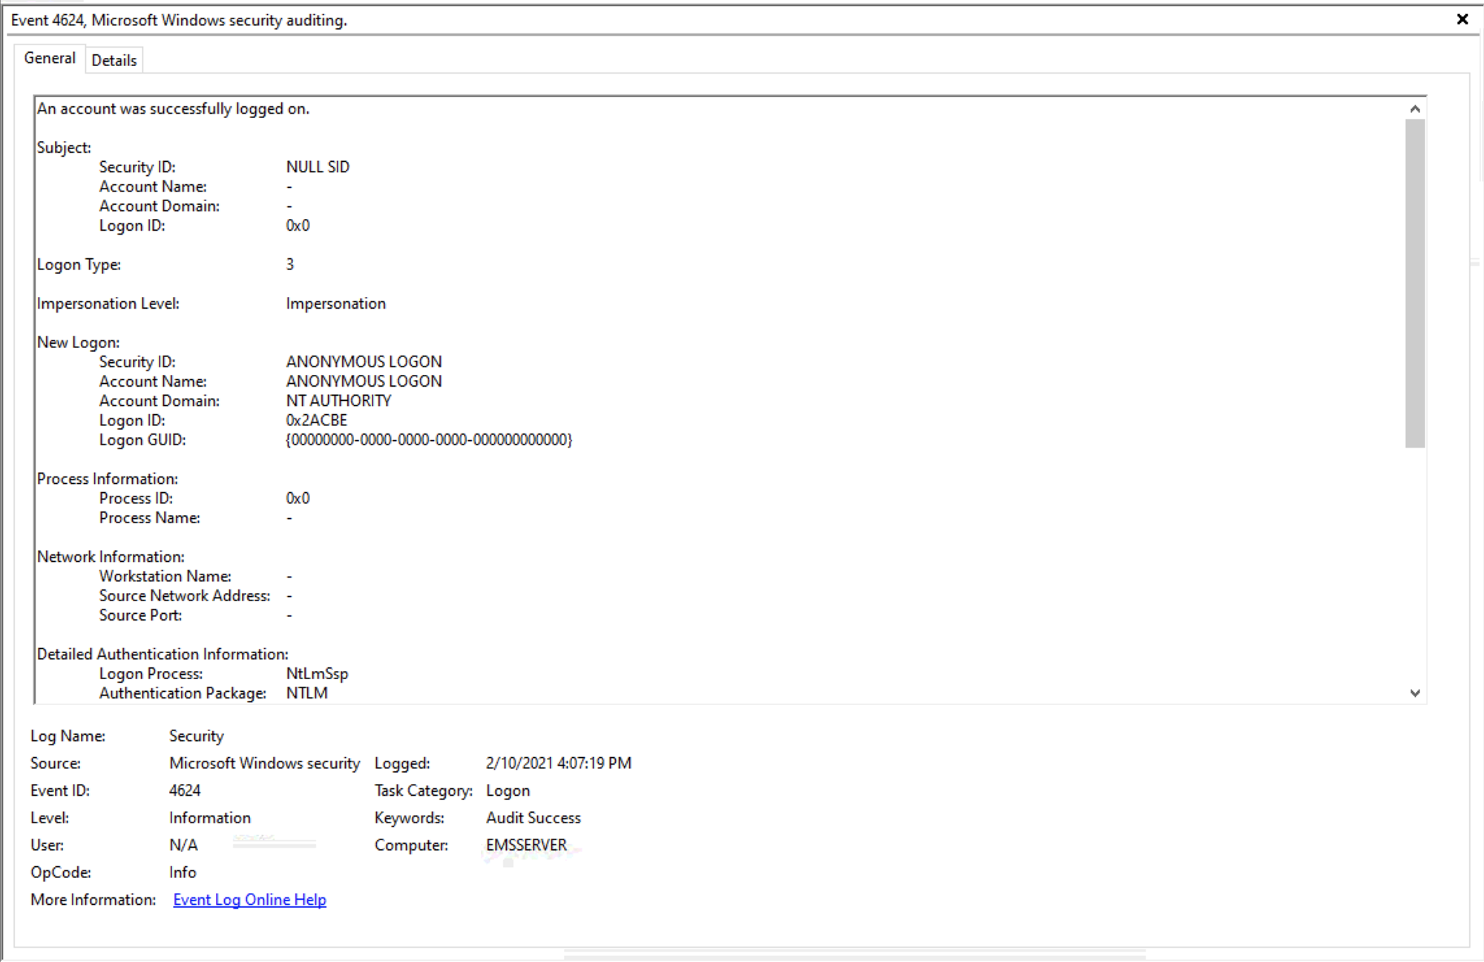
Anonymous Logins
Some Anonymous Login Activity is Normal
Atypical Anonymous Logins Were Discovered

Slide 15
EMS Listening Ports
Analysis Discovered 59 Ports That Were Open on the EMS Server at Boot
Unexpected High Port Listening Activity by Standard Windows Processes (winit.exe, dns.exe, dhcpserver)
IPV6 Enabled
Terminal Services are Enabled
Remote Access is Enabled

Slide 16
EMS Network Connection Attempts on Boot
Process Name | Process File Path | Process ID | Dest IP | Dest Port | Whois
system | system | 4 | 192.168.100.1 | 445 | N/A Local Lan
avastsvc.exe | c:\program files\avast software\avast business\avastsvc.exe | 320 | 23.194.212.49 | 80 | Akamai
avastsvc.exe | c:\program files\avast software\avast business\avastsvc.exe | 320 | 23.194.212.56 | 80 | Akamai
svchost.exe | c:\windows\system32\svchost.exe | 988 | 8.252.68.126 | 80 | Level 3 Parent, LLC
svchost.exe | c:\windows\system32\svchost.exe | 988 | 72.21.81.240 | 80 | Edgecast
svchost.exe | c:\windows\system32\svchost.exe | 988 | 13.107.4.50 | 80 | Microsoft
svchost.exe | c:\windows\system32\svchost.exe | 988 | 23.194.212.104 | 80 | Akamai
svchost.exe | c:\windows\system32\svchost.exe | 988 | 8.240.49.254 | 80 | Level 3 Parent, LLC
svchost.exe | c:\windows\system32\svchost.exe | 988 | 8.252.36.126 | 80 | Level 3 Parent, LLC
svchost.exe | c:\windows\system32\svchost.exe | 1272 | 64.4.54.254 | 443 | Microsoft
svchost.exe | c:\windows\system32\svchost.exe | 1272 | 52.137.106.217 | 443 | Microsoft
svchost.exe | c:\windows\system32\svchost.exe | 1272 | 20.72.205.209 | 443 | Microsoft
jusched.exe | c:\program files (x86)\common files\java\java update\jusched.exe | 4680 | 184.86.196.202 | 443 | Akamai
avastemupdate.exe | c:\program files\avast software\avast business\avastemupdate.exe | 8092 | 104.99.72.230 | 80 | Akamai

Slide 17
Internet History and Connections
Both Maricopa County Audits did Not Find Any Internet History
Significant Internet History Recovered from Unallocated Space
  EMS Server
  EMS Client Workstations
  Adjudication Workstations
  REWEB 1601
  REGIS 1202

Slide 18
EMS Server

Slide 19
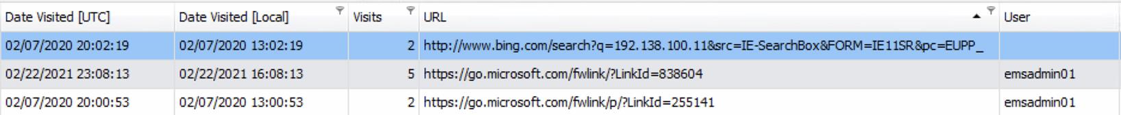
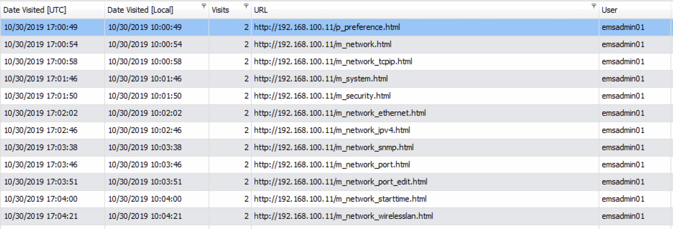
EMS Client 1

Slide 20
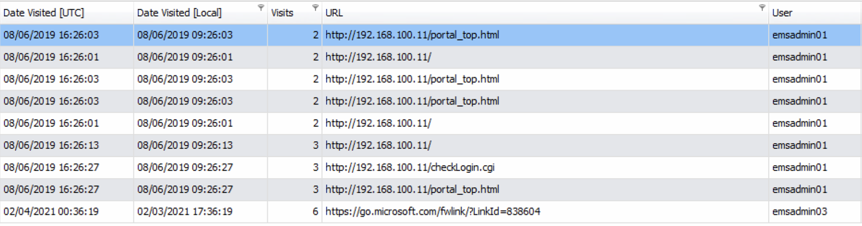
EMS Client 3

Slide 21
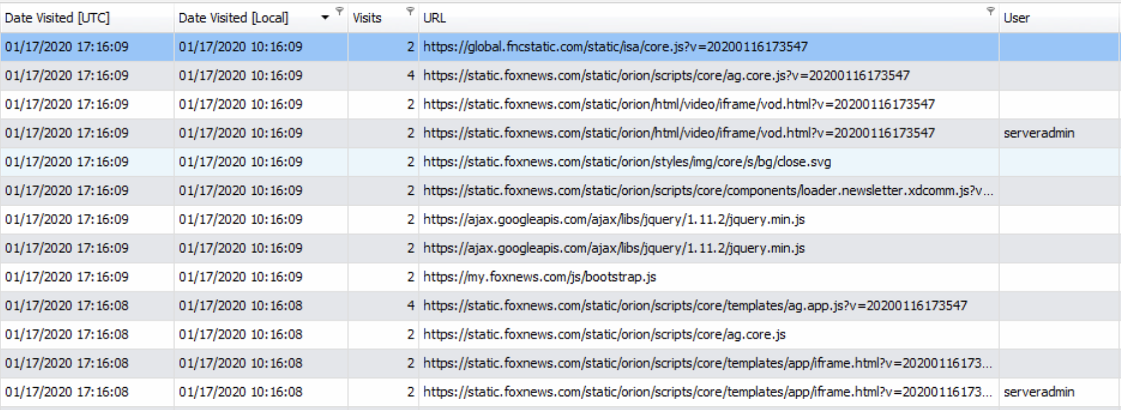
REWEB1601

Slide 22
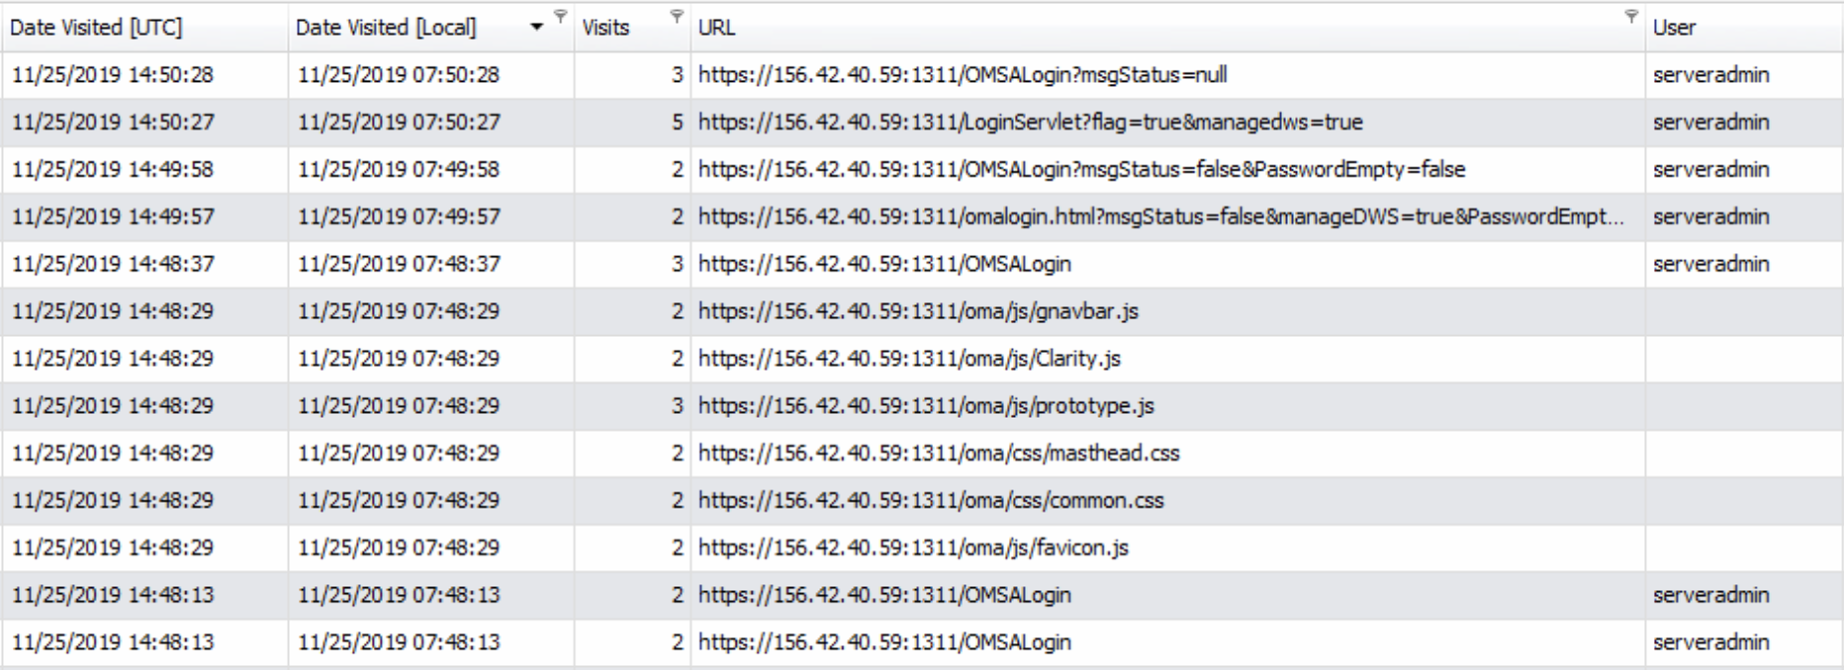
REGIS 1202

Slide 23
Questions?

